Slide 1

A Game Theory Approach to Cascading Behavior in Networks
By
Jim Manning
Jordan Mitchell
Ajay Mattappallil

Slide 2
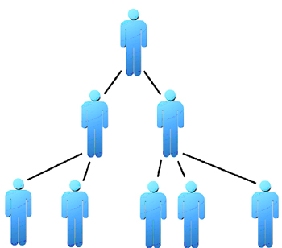
What is Viral Marketing?
Start off with a small group of individuals
“Word-of-Mouth”
Initial individual tells two of his friends and they tell…
Not necessarily selling a
product
Viral ➔ Think Virus

Slide 3

Small-Scale Behavioral Viral Spreading
Two people start singing
Next their friends join in
By the end of the song, the whole bar is singing Mariah Carey’s Fantasy…true story

Slide 4
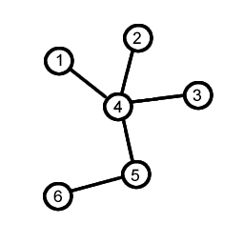
Graph Theory Basics
Nodes
Edges
Directed & Undirected

Slide 5
Graph Theory relating back to VM
Progressive & Nonprogressive
Weighted edges
“Target” node
Contagious

Slide 6
Game Theory
Prisoners’ Dilemma
Two choices
Confess
Don’t Confess

Slide 7
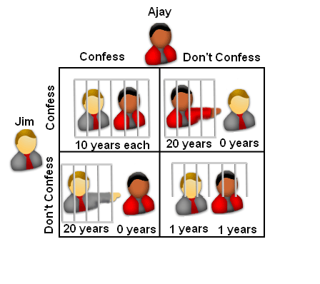
Prisoners’ Outcomes
Payoff
Payoff Table

Slide 8
Zero Sum and Nonconstant Sum Games
Nash Equilibrium
 | Confess | Don’t Confess
Confess | (10,10) | (0,20)
Don’t Confess | (20,0) | (1,1)

Slide 9
Clean Kitchen: $50, Clean Basement: $30, Clean Living Room: $20
 | Kitchen | Basement | Living Room
Kitchen | (25,25) | (50,30) | (50,20)
Basement | (30,50) | (15,15) | (30,20)
Living Room | (20,50) | (20,30) | (10,10)

Slide 10
Apply Game Theory to Viral Marketing
Who are the players?
Behaviors

Slide 11
Agent i’s Payoff
v_{i} g(d_{i}) π_{i} – c_{i}
  v_{i} = benefit from switching
  g(d_{i}) = how number of neighbors affects switch
  π_{i} = % of neighbors already switched
  c_{i} = cost of switching
Will switch if (v_{i} / c_{i}) g(d_{i}) π_{i} > 1
Let F be cdf of v_{i} / c_{i}

Slide 12
Number of Neighbors Effect
One possible g(d) = αd^{β}
If β=0: Only fraction of neighbors activated matters. Matched games.
If β=1: g(d_{i}) π_{i} is proportional to number of neighbors activated. Epidemiology.

Slide 13
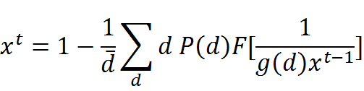
Determining Percent Activated
P(d) is the connectivity distribution
  i.e. percentage of agents in population with exactly k direct neighbors
x^{t} = percentage activated at time t

Slide 14



Connectivity Distribution
Three example types:
  Scale-free networks (power law)
  Homogenous Networks
  Poisson Networks
Larger variance => Product spreads better

Slide 15
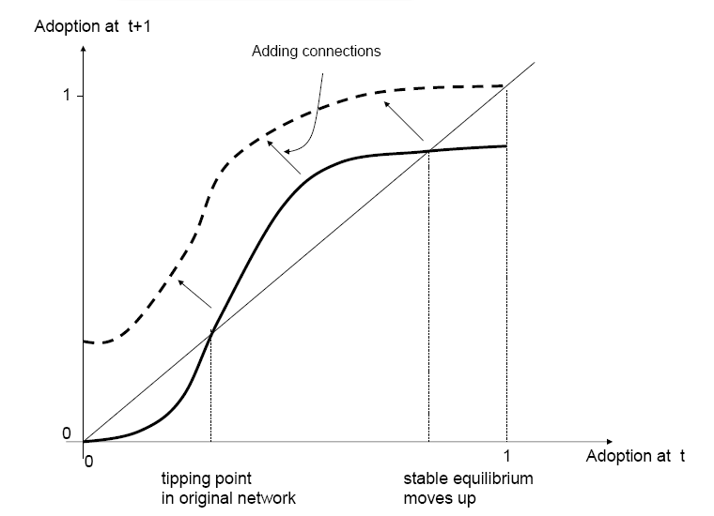
Tipping Point and Equilibrium

Slide 16
Most Influential Nodes
In general, identifying k most influential nodes is NP-hard.
A natural greedy algorithm exists which is a 1−1/e−ε approximation for selecting a target set of size k, using probabilistically determined simulations.

Slide 17
Our Research Direction
Looking for graph types which are not susceptible to strong inapproximability results, and for which good approximation results can be obtained.
Consider graphs with edges weighted differently.
Analyze real world data from social networks or viral marketing campaigns.

Slide 18
Sources
Influential Nodes in a Diffusion Model for Social Networks (David Kempe, Jon Kleinberg, Eva Tardos):
http://www-rcf.usc.edu/~dkempe/publications/influential-nodes.pdf
Diffusion on Social Networks (Matthew O. Jackson):
http://economiepublique.revues.org/docannexe1777.html
The Diffusion of Innovations in Social Networks (H. Peyton Young):
http://www.brookings.edu/~/media/Files/rc/reports/1999/05fixtopicname_young/diffusion.pdf
Information Diffusion in Online Social Networks (Lada Adamic):
http://www.eecs.harvard.edu/~parkes/nagurney/adamic.pdf
Diffusion in Complex Social Networks (Dunia Lopez-Pintado):
http://www.sisl.caltech.edu/pubs/diffusion.pdf
Social Networks and the Diffusion of Economic Behavior (Matthew O. Jackson):
http://www.stanford.edu/~jacksonm/yer-netbehavior.pdf
Cascading Behavior in Networks: Algorithmic and Economic Issues (Jon Kleinberg):
http://www.cs.cornell.edu/home/kleinber/agtbook-ch24.pdf

Slide 19
Thank you for your attention!
Questions?

